Slide 1
Software maintenance

Slide 2
Software maintenance is a part of the SDLC.
Software Maintenance is the process of modifying a software product after it has been delivered to the customer.
The main purpose of software maintenance is to modify and update software applications after delivery to correct faults and to improve performance.

Slide 3
Need for Maintenance
Software Maintenance is needed for:-
Correct errors
Change in user requirement with time
Changing hardware/software requirements
To improve system efficiency
To optimize the code to run faster
To modify the components
To reduce any unwanted side effects.

Slide 4
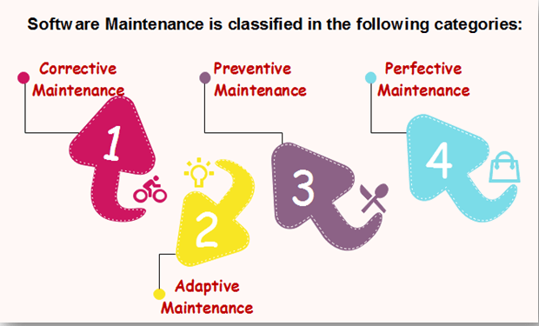

Slide 5
Corrective Maintenance
Corrective maintenance aims to correct any remaining errors regardless of where they may cause specifications, design, coding, testing, and documentation, etc.
Adaptive Maintenance
It contains modifying the software to match changes in the ever-changing environment.

Slide 6
Preventive Maintenance
It is the process by which we prevent our system from being obsolete.
It involves the concept of reengineering & reverse engineering in which an old system with old technology is re-engineered using new technology.
This maintenance prevents the system from dying out.

Slide 7
Perfective Maintenance
It defines improving processing efficiency or performance or restricting the software to enhance changeability.
This may contain enhancement of existing system functionality, improvement in computational efficiency, etc.

Slide 8
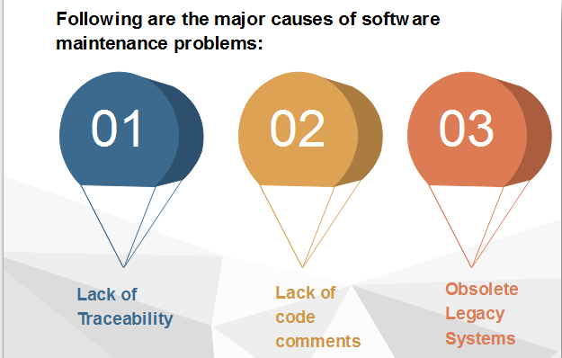

Slide 9
Lack of Traceability
Codes are rarely traceable to the requirements and design specifications.
It makes it very difficult for a programmer to detect and correct a critical defect affecting customer operations.
Like a detective, the programmer pores over the program looking for clues.

Slide 10
Lack of Code Comments
Most of the software system codes lack adequate comments.
Lesser comments may not be helpful in certain situations.

Slide 11
Obsolete Legacy Systems
In most of the countries worldwide, the legacy system that provides the backbone of the nation's critical industries, e.g., telecommunications, medical, transportation utility services, were not designed with maintenance in mind.
They were not expected to last for a quarter of a century or more!

Slide 12
What is Software Supportability?
Software Supportability is the capability of supporting a software system over its whole product life.
This implies satisfying any necessary needs or requirements, but also the provision of equipment, support infrastructure, additional software, facilities, manpower, or any other resource required to maintain the software operational and capable of satisfying its function

Slide 13
What does Software Support encompass
Software Support covers the whole software life-cycle once it enters into service.
In particular, it covers the following key aspects associated to the software:
Operation
Logistics Management
Modification

Slide 14
Operation covers all aspects associated to the actual use of the software, including the installation, loading (or unloading), configuration, error recovery and execution of the software.
Logistics Management covers all aspects related to the handling of the software once a new baseline has been produced, until its delivery to the end user.

Slide 15
Modification (often mistakenly called Software Maintenance) covers all aspects related to the evolution of the software due to the need of fixing bugs, or adding/changing functionality due to changing user needs.

